Slide 1
The fight against herbicide resistance: what have we learned after five years of research
Trevor James

Slide 2
Talk outline
Why did we want to look at herbicide resistance?
Who did we work with?
What did we set out to do?
What did we achieve?
Take home messages?

Slide 3
What we didn’t want to see
Herbicide resistance in NZ

Slide 4
Our Financial Stakeholders
Foundation for Arable Research
Bragato Research Institute
LandWise
HortNZ
Nufarm
Bayer
Syngenta

Slide 5
Our 4 Research Areas
RA1. Anticipating herbicide resistance
Phil Hulme Lincoln University - Big Data
RA2. Changing herbicide practices
Martin Espig & Roxanne Henwood AgR – Why don’t growers take notice
RA3. Identifying instances of resistance
Kerry Harrington, Hossein Ghanizadeh, Chris Buddenhagen & Andrew Griffiths – Identification and survey
RA4. Managing herbicide resistant weeds
Trevor James, Dan Bloomer, Chris Buddenhagen, Maureen O’Callaghan & Katherine Tozer – Non-herbicide weed control

Slide 6
Hierarchical cluster analysis
Used to identify groups of countries with similar herbicide-resistant weed assemblages to New Zealand that results from similarities in agronomic and environmental conditions
A distinct cluster of 11 European countries with strong climatic and agronomic affinities to New Zealand was identified
Species with potential to become herbicide resistant in New Zealand included established crop weeds as well as species only encountered as contaminants of seed imports

Slide 7
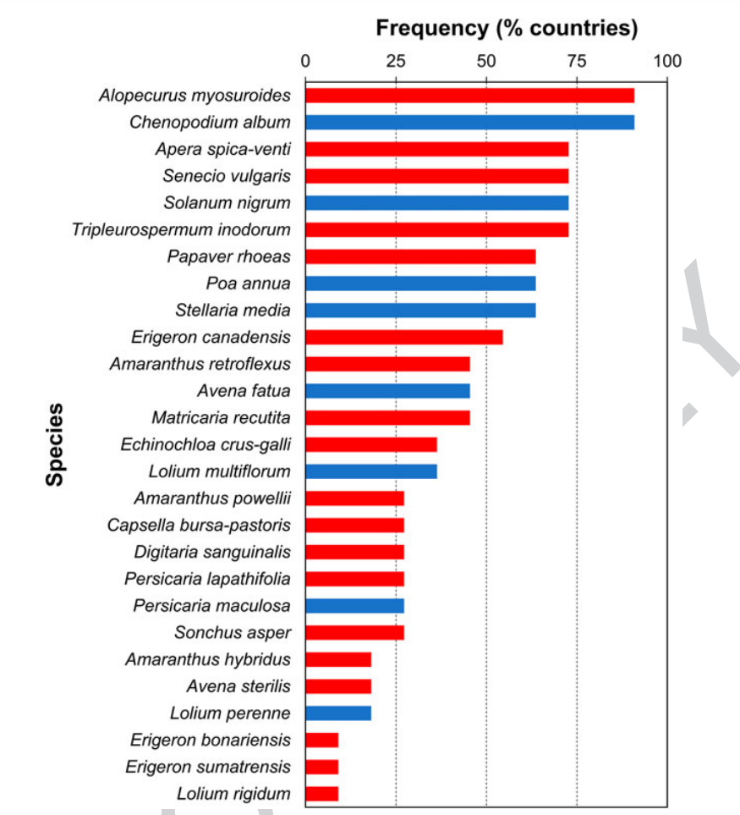
A risk map
Not resistant in NZ
Resistant in NZ
Import threats
Emerging grass weeds
Common broadleaved weeds

Slide 8
Drivers of herbicide use
Agrichemical system
Market demands
Crop contract system
Agricultural system
Regulatory system
Profitability
Practicality
Natural factors
Crop rotations
Farm system
Conflicting priorities
Technology & infrastructure
Knowledge and skills
Awareness
Motivation to act
Individual
Attitudes and beliefs
Decision-making process
Notes:
Awareness - Perceived severity of HR determines if it is regarded as a problem
Attitudes & beliefs - Views that diverse crop rotations or new herbicides prevent HR can lead to lower motivation to review current practices
Knowledge & skills - Ability and confidence to enact practice changes that suit one’s farm system
Motivation to act - A focus on practical and profitable production systems that impacts perceived ability to alter weed management
Decision-making process - Herbicide choices influenced by crop decisions and input from advisors, often with limited longer-term HR strategies
Crop rotations - Crop decisions precede herbicide choices, with fast crop turnover increasing herbicide use.
Conflicting priorities - Competing demands for financial viability and environmental performance can limit ability to alter weed management.
Practicality - Intensive agricultural systems and established production processes are seen to require synthetic herbicides.
Technology & infrastructure - Not owning spraying gear and technical limitations of harvesting equipment can determine how herbicides are applied.
Natural factors - Environmental conditions that impact herbicide use, such as plant characteristics or weather patterns.
Crop contract system - Many crops grown under competitive seasonal contracts, which can restrict ability for long-term weed management strategies.
Agrichemical system - Available brands and sales targets might influence use recommendations, as well as herbicide labels as information sources.
Regulatory system - National regulations that can restrict or allow specific herbicides being used.
Market demands - Certification for international seed export drives increased herbicide use, while consumer preference may exclude others.
Profitability - Economic pressures prompt more intensive operations with increased herbicide use, but pecuniary drivers often not end in themselves.

Slide 9
Economics
Based on a model farm
– concluded that farmers would exhaust cheaper weed control options unless they needed to do something about resistant weeds!

Slide 10
Developing genetic Quick Tests
High Resolution Melting (HRM) – High-throughput
Targeted: 5EPSPS - GLYPHOSATE
  Seed or leaf DNA extraction (96 well format)
  Visualisation using High Resolution Melt analysis (HRM)
TaqMan probes – High throughput, pool samples
Targeted: 5EPSPS - GLYPHOSATE
  Seed or leaf DNA extraction (96 well format)
  Labelled probe binds to mutation
  Commercially with Slipstream Automation (Palmerston North)
    cost-effective? ~$4.00/sample in batches of 96 (incl DNA extraction)
mcook@slipstream-automation.co.nz

Slide 11
GTseq: Summary
GTseq worked across three Lolium species (L. perenne; L. multiflorum; L. hybridum)
Testing on: wild oat (Avena fatua); Phalaris spp.; Bromus spp.; Poa spp.; Blackgrass (Alopecturus)
Cost ~$18-21 per sample (including DNA extraction/sequencing/analysis)
  Screens three MOA simultaneously across 32 sites
  Establishing as a commercial service
Ideal for screening pre-breeding material/cultivar development

Slide 12
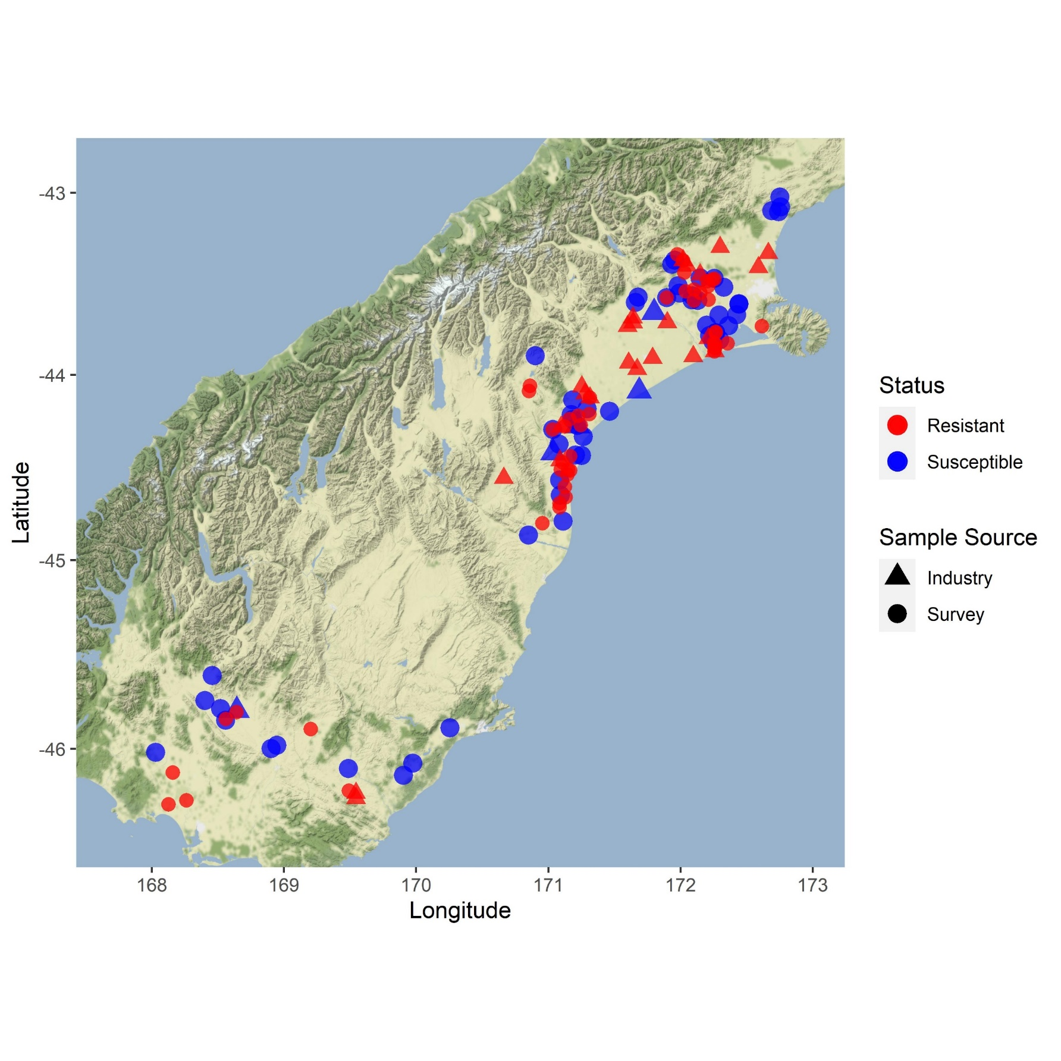
Farms with a resistant weeds
Ryegrass
Sow thistle
Prairie grass
Chickweed
Wild oats
Seek and you shall find

Slide 13
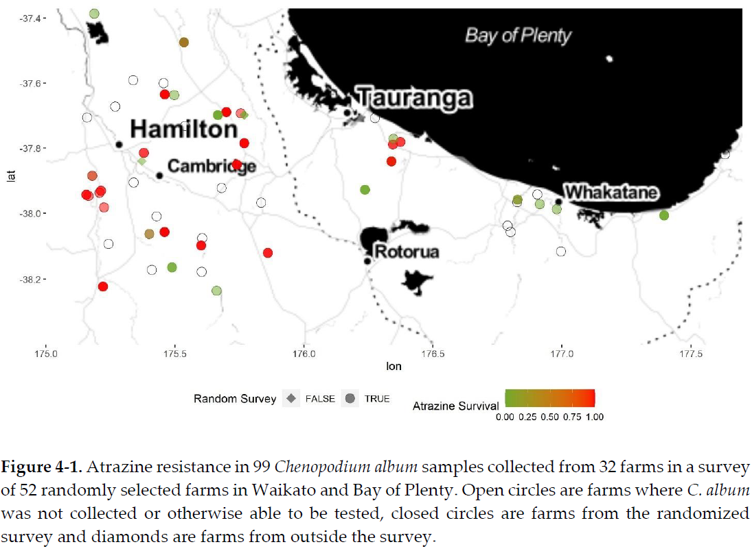
Fathen

Slide 14
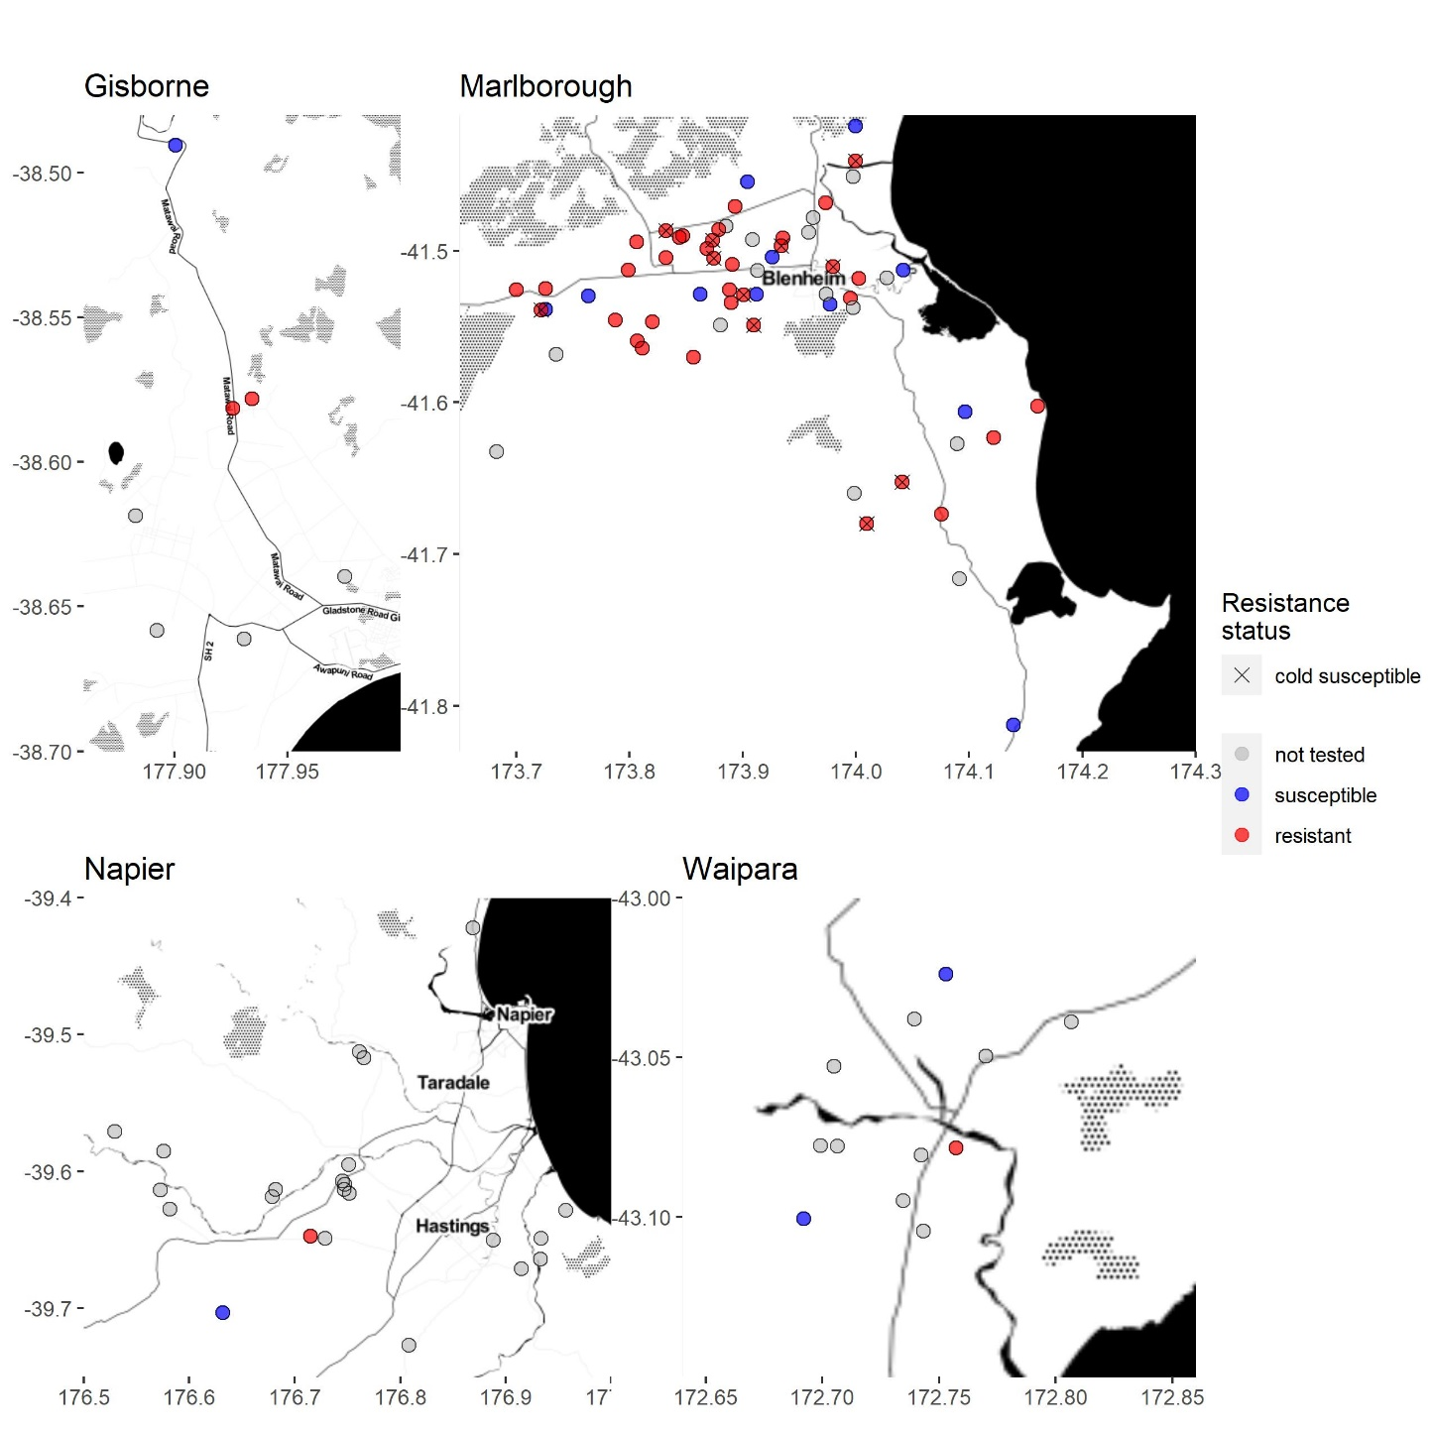
Overall 38% of vineyards surveyed had glyphosate resistant ryegrass,
57% in Marlborough
Nine vineyards resistant to amitrole as well as to glyphosate

Slide 15
New NZ HR cases
New cases
Phalaris minor (iodosulfuron, wheat)
Poa annua (iodosulfuron, wheat)
Bromus catharticus – (pyroxsulam, wheat)
Lolium perenne – (glyphosate, barley)
Sonchus asper, S. oleracea – (chlorsulfuron, wheat)
More cases
Stellaria media – (chlorsulfuron, flumetsulam, ryegrass and wheat)
Digitaria sanguinalis – nicosulfuron (maize survey)
Lolium spp. – (glyphosate and amitrole vineyards)
Chenopodium album – (atrazine, maize) -surveys
Less cases
Persicaria maculosa – (atrazine, maize)
Chenopodium album – (dicamba, maize)

Slide 16
Take home impacts – 1 Maize grain yield by cover crop

Slide 17
Weed Control: Relative Energy Requirements
2,600
260
26
2.6
0.26
0.026
Energy Estimates (MJ/ha)
Energy Estimate Diesel Equivalents (L/ha)
Pulsed micro shocks
Targeted Weeding assumes 5 weeds/m²
Based on Data from Coleman et al (2019)¹, Kaufman and Schaffner (1980,1982)², Barber (2006)³
Notes:
Data converted to litres of diesel per hectare equivalent

Slide 18
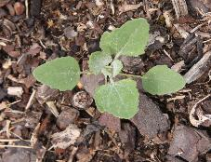
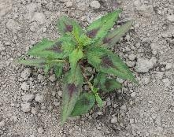
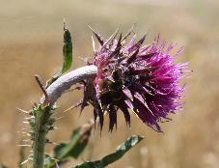
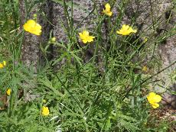
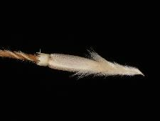
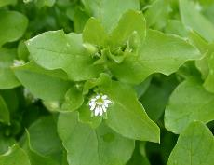
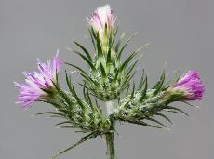
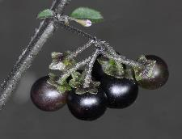
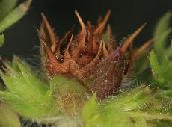
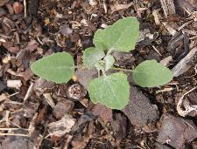

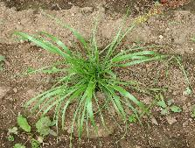
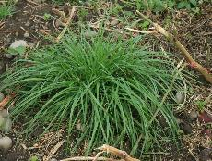

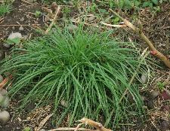
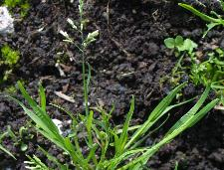
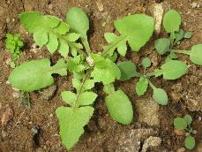
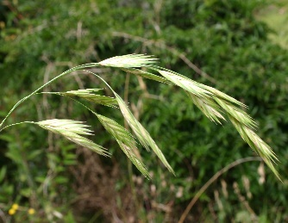
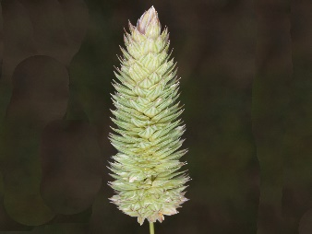
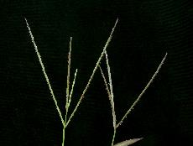
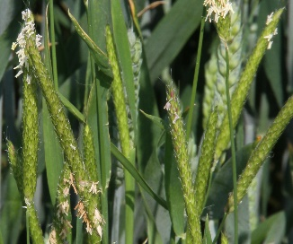
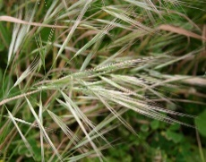
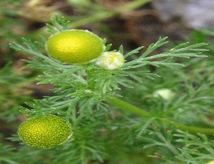
Herbicide resistance in NZ after 5 years surveying
1979
Fathen
atrazine
1980
Willow weed
atrazine
1981
Nodding thistle
2,4-D
1988
Giant buttercup
MCPA
1992
Needlegrass
dalapon
1995
Chickweed
chlorsulfuron
1997
Winged thistle
MCPA, 2,4-D
1999
Black nightshade
atrazine
1999
Onehunga
clopyralid
2005
Fathen
dicamba
2009
Black nightshade
paraquat
2010
Giant buttercup
flumetsulam
2012
Italian ryegrass
glyphosate
2012
Perennial ryegrass
glyphosate
MHR 11 (12) new species
2014
Wild oats
fops
2014
Perennial ryegrass
sulfonylureas
2015
Perennial ryegrass
amitrole, glufosinate
2015
Italian ryegrass
amitrole, glufosinate
2017
Italian ryegrass
Fop, dim, den
2020
Annual poa
haloxyfop
2021
Sow thistle
sulfonylureas
2021
Prairie grass
pyroxsulam
2021
Lesser canary
grass
Group 1 & 2
2021
Summer grass
sulfonylureas
2021
Perennial ryegrass
Group 1
2021
Annual poa
iodosulfuron
2021​
Blackgrass
iodosulfuron
2022
Willow weed
chlorsulfuron
2023 Ripgut brome sulfonylureas
2023 Rayless chamomile sulfonylureas
2023 Wild carrot?

Slide 19
What we did see (unfortunately)
Herbicide resistance in NZ

Slide 20
Our outputs

Slide 22
Main outcomes
Destigmatising HR for farmers and industry
- Growers Leading Change group HR
Allowed next steps to happen
- Workshops on IWM
Started conversations on importance of agronomist to work together on farms
Notes:
Openly talk about resistance
Phoning each grower
Meeting in group – strategies
This is what needed to happen for farmers to realised that resistance is widespread and for change to be able to happen

Slide 23
Lessons learnt
Resistance is widespread on arable farms
Resistance is a bigger problem in areas where grass seed crops are grown and rotation options are limited
Growers more willing to consider other management options
We can control grass weeds in cereals without Groups 1 and 2

Slide 24
Thank you
I am grateful for the opportunity to have worked alongside you all and look forward to working again together in the future

