Slide 1
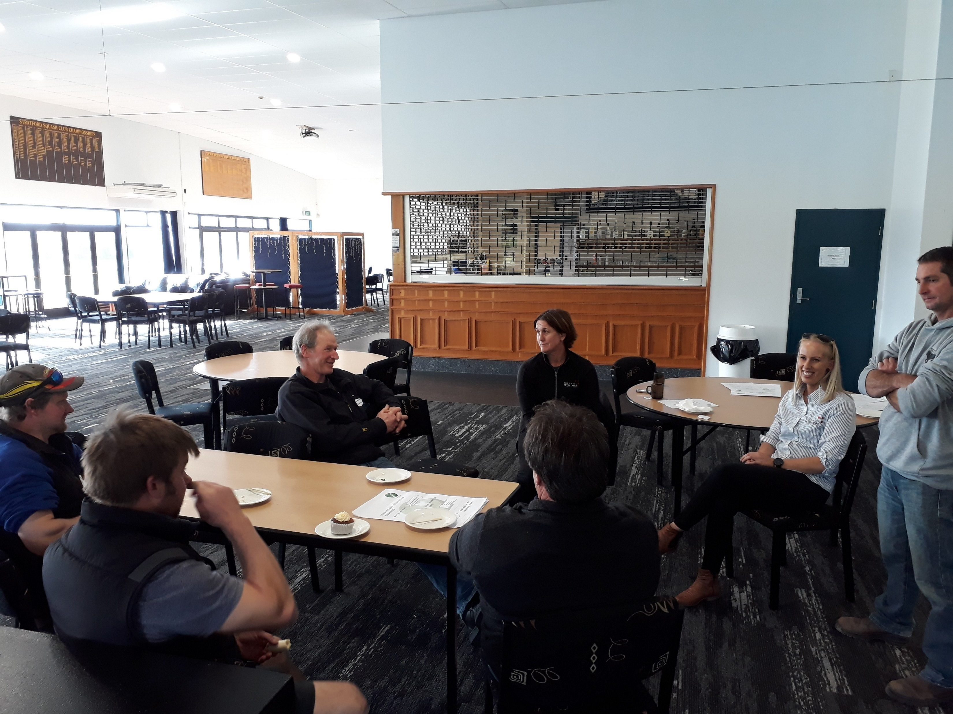
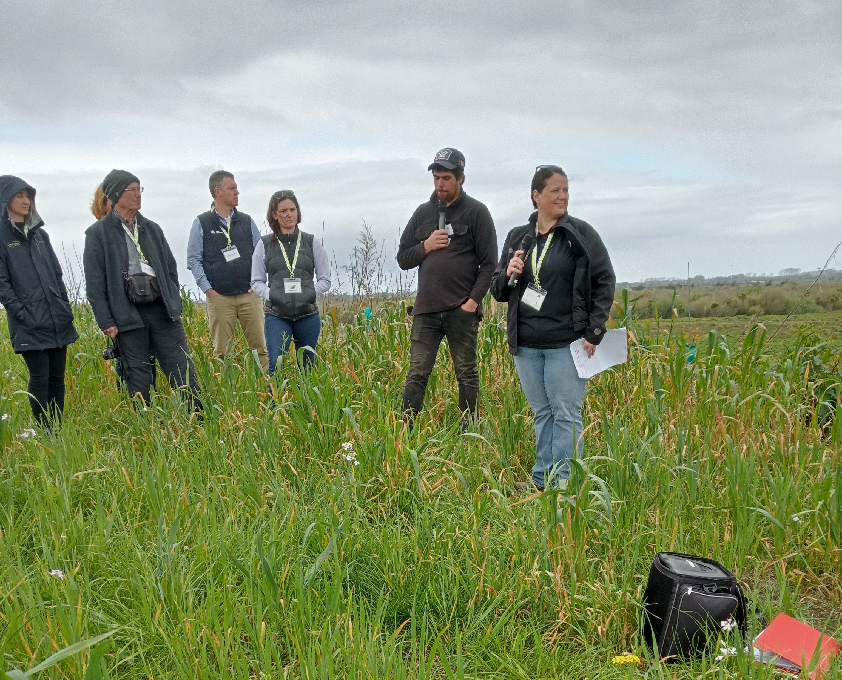
November 2023
Effective extension programmes
Understanding the role of extension

Slide 2
Extension is
Q
… a tool for facilitating change on-farm / on-orchard / amongst landowners.

Slide 3
The role of extension
Q
… is to accelerate adoption by reducing the time and effort farmers must invest in learning.

Slide 4
Extension provides
Q
… non-formal education and learning activities to farmers, growers, producers and others.

Slide 5
What does an effective extension programme involve?

Slide 6
Designing extension programmes
Three parts to effective extension design
Understand and document:
The change required
Your audience
The activities and events which connect and support these

Slide 7
Bringing it all together

Slide 8
Understand the change required
What does the change look like?
Useful frameworks:
Structured and formal: Bennett’s Hierarchy
Modified version of Bennett’s – Crisp
Quick and dirty: Workshop with the project team / chat to experts

Slide 9
Bennett’s hierarchy
7. End results
6. Practice change
5. KASA change
4. Reactions
Knowledge
Attitude
Skills
Aspirations
3. People involvement
2. Activities
Source: Bennett, C.F. 1979, Analysing Impacts of Extension Programs, Science and Education, USDA, Washington, USA.
1. Inputs

Slide 10
An alternative framework
4. Improved EES
Environmental, economic, social conditions
3. Practice change
2. KUS change
Knowledge
Understanding
Skills
1. Awareness
Source: Crisp, J. 2010, Planning extension activities for impact, Extension Farming Systems Journal, 6(1) 135-138.

Slide 11
Understand your audience
Get to know your audience
Different approaches to this:
Structured and formal: Geoff’s approach
Quick and dirty: Using the questions from Geoff’s approach (asking and listening!)

Slide 12
Extension programme
Extension programme
Focus on biodiverse planting in perennial crops
Change:
Increase use of crop monitoring
Target audience:
Growers in regions where pest pressure is low
Others who may be interested in finding out more
Activities:
Practical workshop: identifying beneficials
Practical workshop: fitting crop monitoring into routine orchard work
Promoting online resources associated with these workshops

Slide 13
Some resources
Enablers of change
Bennett's Hierarchy
Free video/podcast/blog on extension
Some more detail on using Bennett’s Hierarchy to design programmes
Planning framework
Papers
More detail on Crisp and Holt’s planning frameworks for extension
Crisp 2010
Bennett 1979

