Slide 1
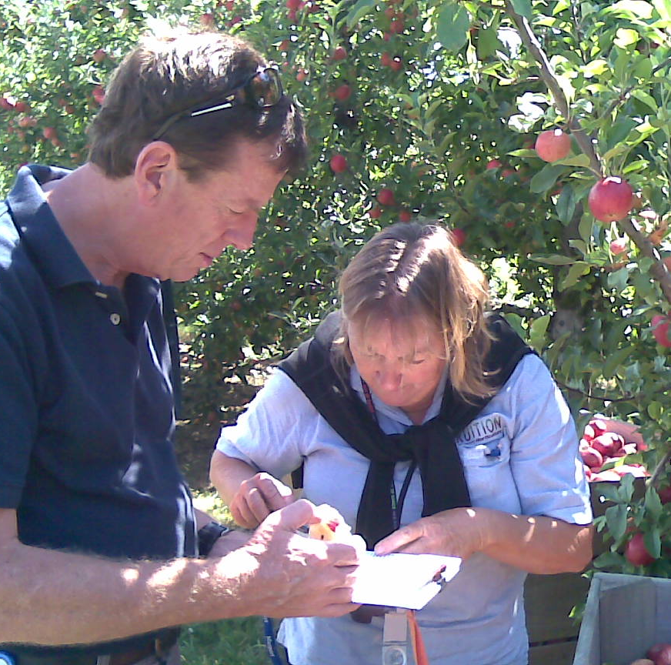
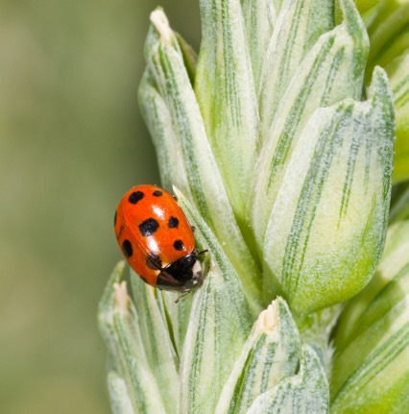
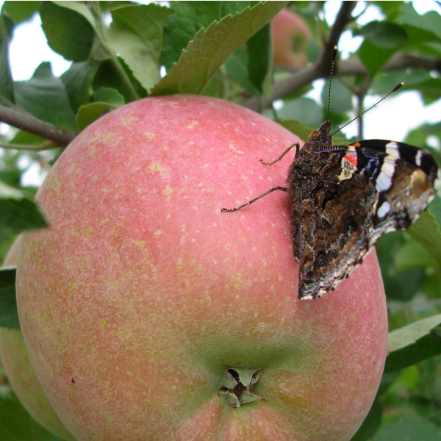
From innovation to implementation the IFP-Apple Futures story
Dr Jim Walker
Principal Scientist, Plant and Food Research
Notes:
Select one cover option and delete the unused variations.

Slide 2
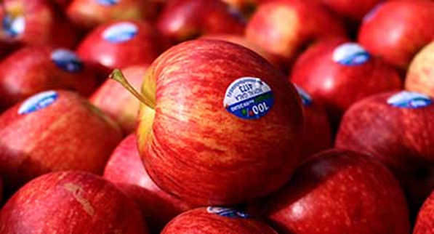
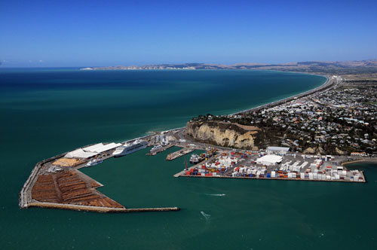

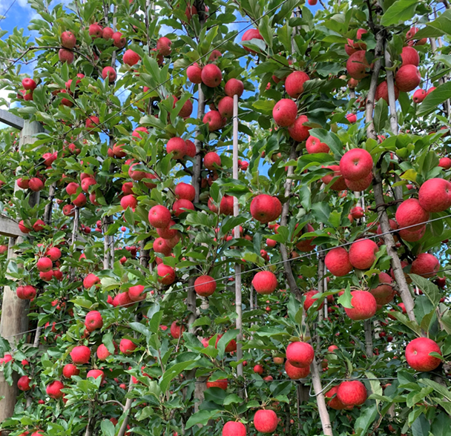
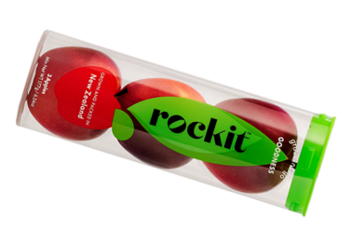

New Zealand apples background factors driving export programmes
Statistics
940 orchards, ~250 growers
10,000ha, 600,000 tonnes
90% of Class 1 apples exported
~$900M export revenue
Export drivers
small domestic market
2/3rd of cost past orchard gate
  premium export markets
  innovation & new cultivars
  productivity with sustainability

Slide 3


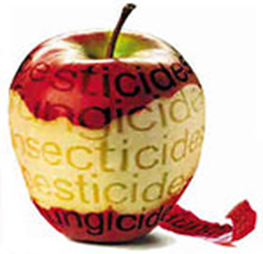



The apple industry’s sustainability journey
A timeline of crop protection changes
Export conundrum
>70 countries
pest & disease-free
near ‘residue-free’
Responsible use GlobalGAP ‘Residue-free’
Pre-1996
calendar spraying for crop protection
Deregulation of the apple industry
100% Pure Apples brand launched
Integrated Fruit Production introduced
Apple Futures introduced
Smart & Sustainable
Profits plummet to -19.5%
Apple Futures II
Asian market access
1995
1997
1999
2001
2003
2005
2007
2009
2011
2013
2015
2017
2019
2023
UK/Europe supermarket Assurance Programmes
New EU regulatory & supermarket restrictions on pesticides
Asian market growth & profitability
Notes:
Talk about IFP, Pipsafe, etc using this slide

Slide 4
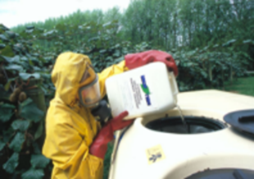
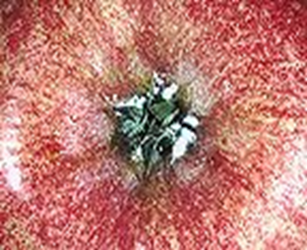
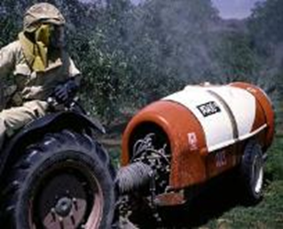
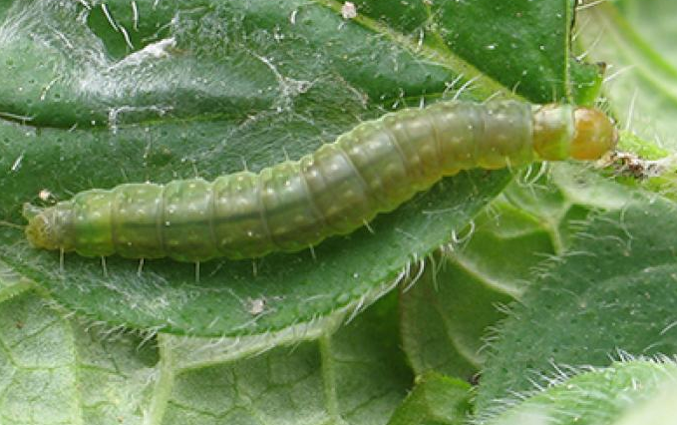









Development of the apple IFP programme
Production drivers (1995)
Insecticide resistance (leafrollers, mealybugs)
Extreme insecticide toxicity (OPs)
Worker safety and environmental toxicity
Export rejection >18% risked market closure
Integrated Fruit Production
Sustainable production using the safest possible methods for the environment and human health
The vision
The future - responsible insecticide use
A deep-redesign of apple crop protection
Team building (1995)
Co-leadership
Sector stake-holders
Consultant & community engagement
Leading growers
+

Slide 5

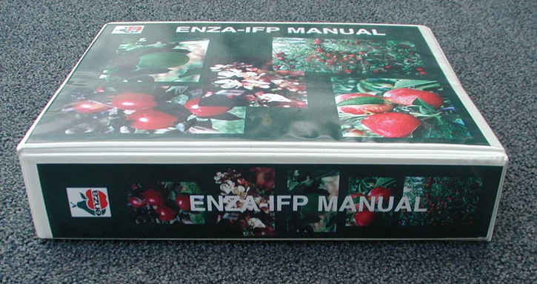
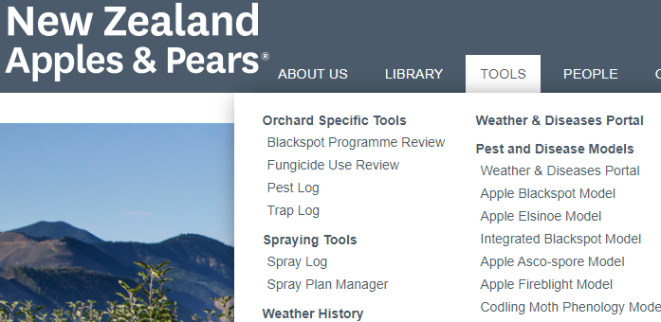
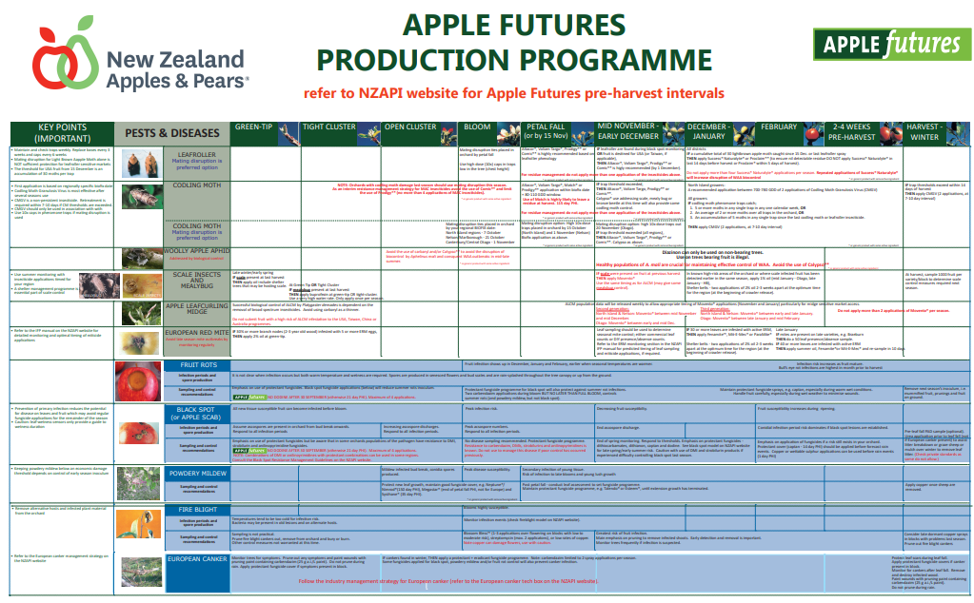
NZ Pipfruit IFP Committee
(1996-2001)
ENZA HortResearch Sector Groups Growers
Technical Subcommittees
Pests
Diseases
Chemical effects database
Site and rootstocks
Tree management
Understorey management
Water management
Soil management
Environmental quality
Cleaner production
Training
Regulatory
IFP Standards
(goals)
Pests
Eliminate ecotoxic OP insecticides
Only justified pesticide use
Maximise bio-control
Reduce quarantine failures
IFP Documents
1996
Implementation
Agchem industry
Merchant suppliers
Consultants
Growers
Researcher led
Notes:
The New Zealand IFP Committee for pipfruit was established in early 1996.
It is chaired by Catherine Richardson from ENZAFRUIT and has scientific representatives from HortResearch,
but it includes representatives from various sectors including consumer, environmental and agrochemical advocates
and importantly, grower representatives from each region.
There are 12-15 Technical Subcommittees responsible for the development of IFP standards, and the technical sections of the IFP Manual.
ENZAFRUIT is the key driver responsible for the implementation of IFP throughout New Zealand fruit producing districts.

Slide 6
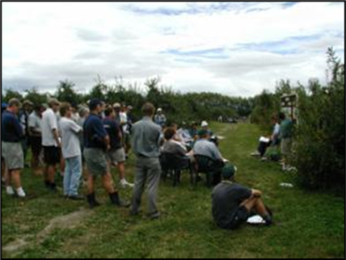

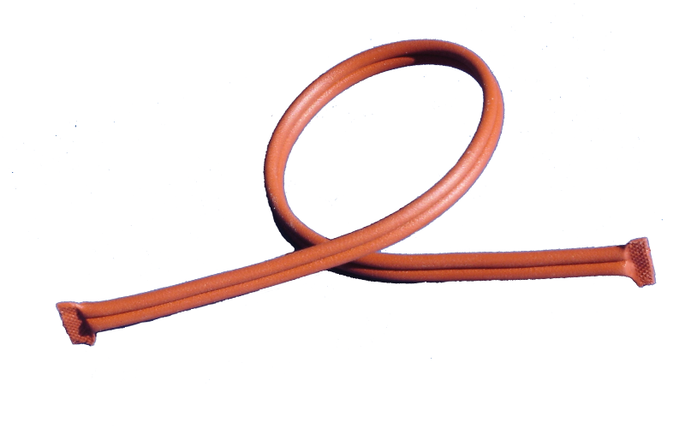
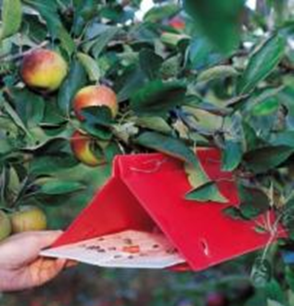

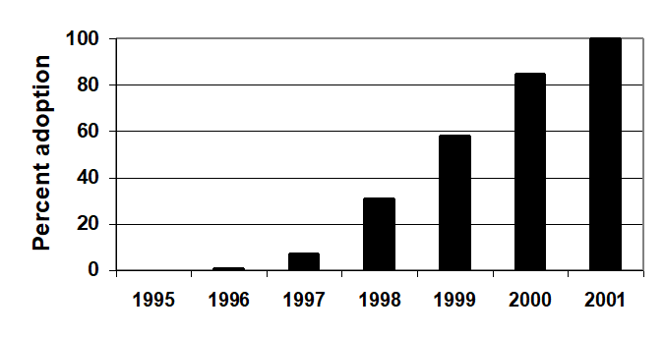
IFP implementation (1996-2001)
Technology, stakeholders, consultants & growers
New soft technologies
Selective pesticides
Pheromone traps
Mating disruption
Discussion Groups
each15-20 growers
3 sessions
per year
~75 groups
Facilitator
Researcher
Stakeholder engagement
Agchem industry forums
Changes signalled
Planning for change
Merchants/Consultants
Training: pest identification
New crop monitoring services
IFP adoption nationally
IFP incentive per carton
Pilot program
+ 25c
- 75c

Slide 7
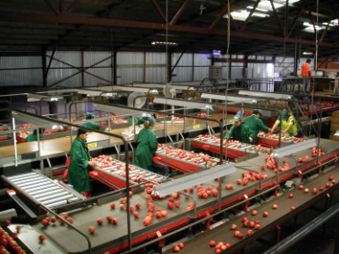
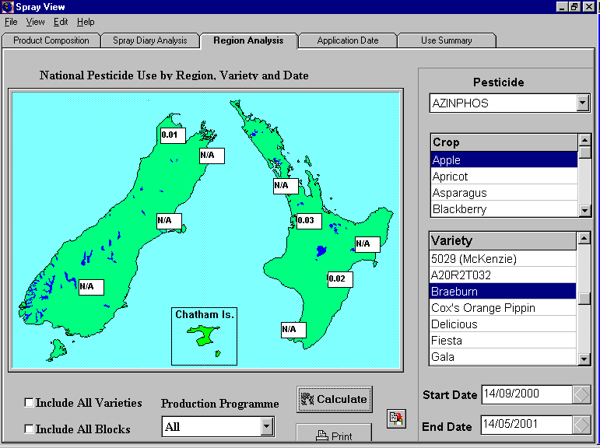
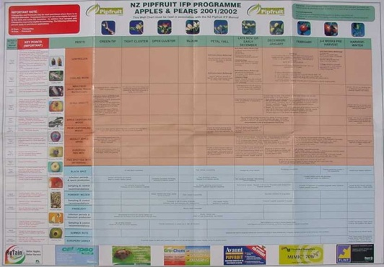
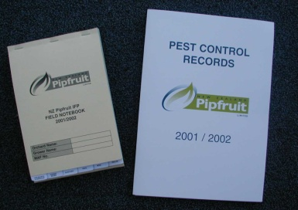

Continuous improvement of IFP recommendations importance of feedback loops
Grower issues
Understand tolerance of risk
Understand their concerns
Accept & address issues
Modify recommendations
Fruit quality
Pest incidence
Whole industry data
Continuous improvement
Programme issues
Crop risk management
Confidence in programme
Integrity of grower data
Growers’ sharing data – trust!
Pesticide use analysis
IFP Wall Chart
annual updates
Spray diary data
Grower records

Slide 8
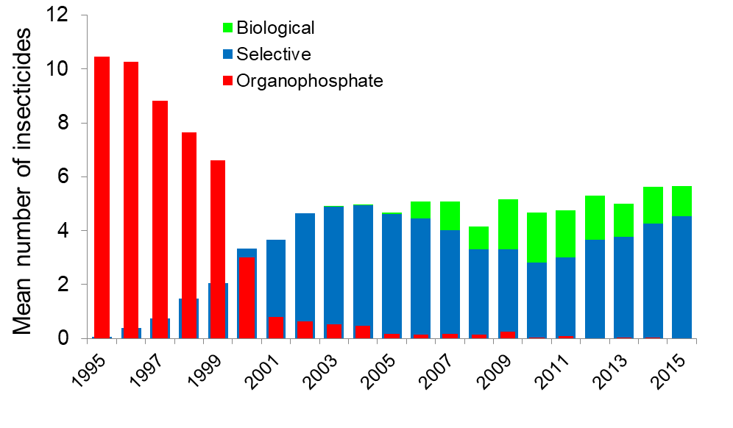
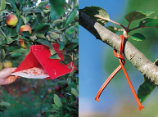
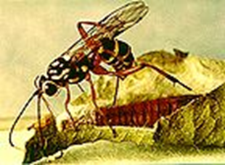
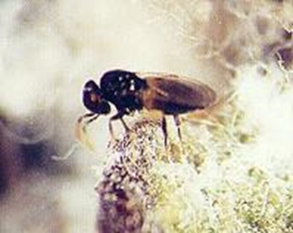
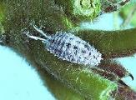
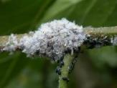

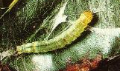
Integrated Fruit Production (IFP):
sector-wide, long term insecticide use
Selective pesticides
maximised biological control
Mating disruption
Pests that decreased
By 2005
Insecticide frequency had reduced by >50%
Selective insecticides favoured natural enemies
Major biological control benefits

Slide 9
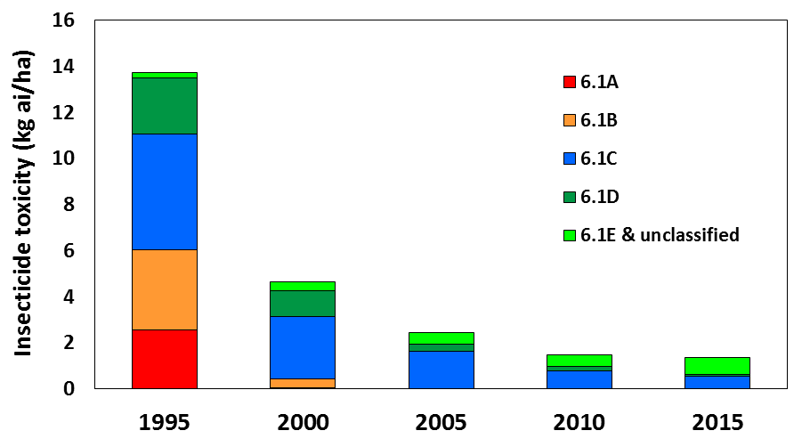

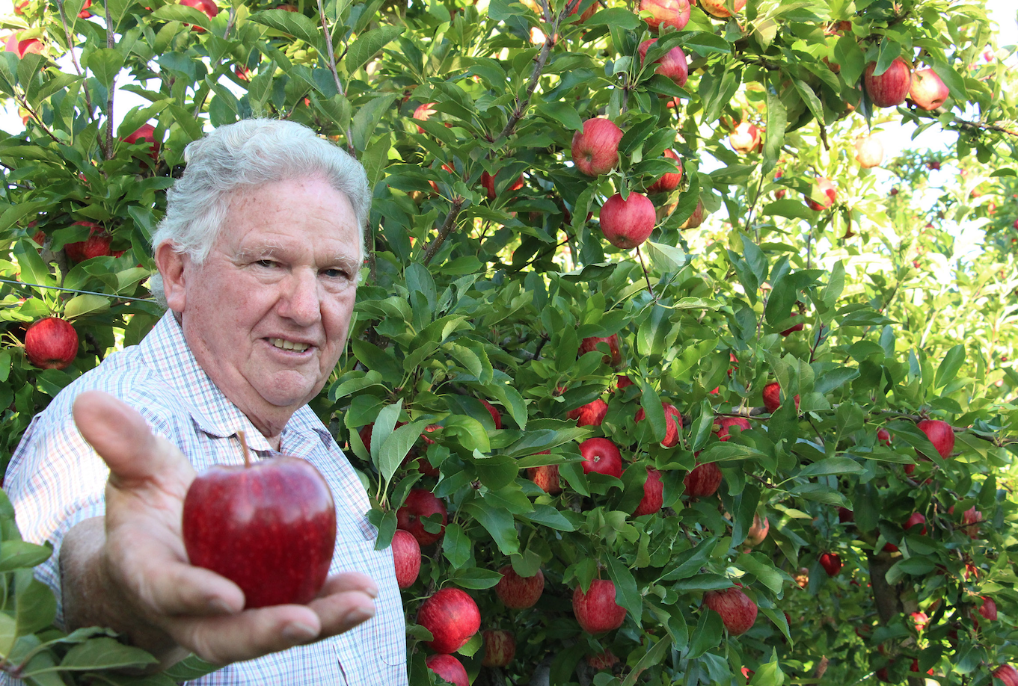
IFP pest management outcomes
The other IFP bonus outcomes
Reduced insecticide footprint
Improved export performance
Acute toxicity


Toxicity: >1000-fold reduction
Loading: 80…90% less per ha
Decreased inspection failures
Improved access to markets
By 2005
Gone - highly toxic & eco-toxic insecticides
New grower awareness of biocontrol!
Safer working & better orchard environment
But emerging EU focus on ‘residues’
“Can’t continue like this. We need a universally marketable apple”

Slide 10

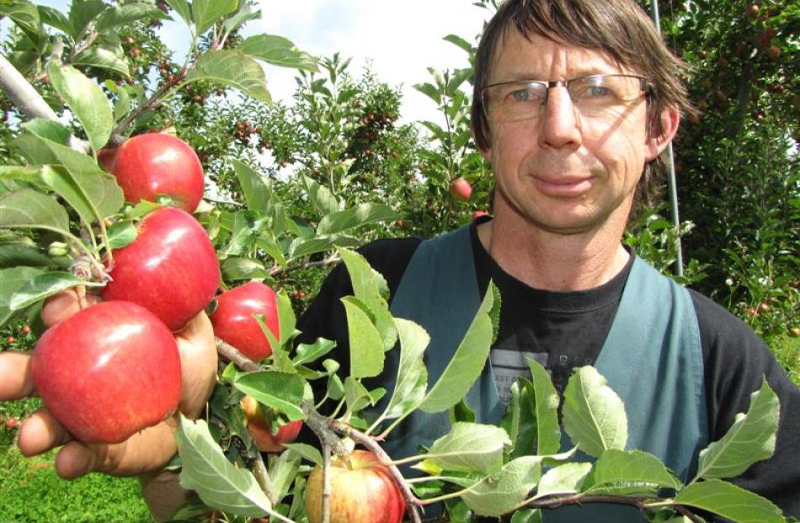
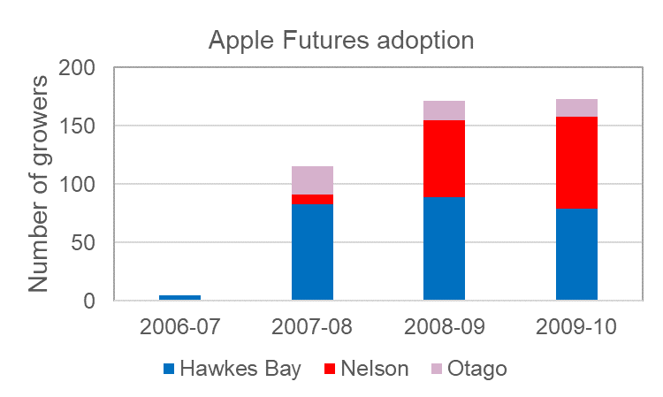
Apple Futures programme the next EU market & regulatory challenge
IFP with ultra-low residues (2006-10)
‘Pipsafe’ – a pilot programme (SFF)
Trusted access to sectors’ residue tests
Targeted the ‘persistent’ agrichemicals
Produced export quality fruit with low residues
We can do it!
Apple Futures programme (T&E MRI)
Goal: Production of low residue apples while meeting the phytosanitary requirements of over 65 countries
Features
Product selection based on decay curves
100s of residue tests, new with-holding periods
Target for all residues:
  zero, or up to 10% of EU allowable residue
  ≤ 3 residues per crop
Over-subscribed
390 in HB alone

Slide 11

Apple Futures by the final year the end of the global financial crisis
Apple Futures: 63% of apple area (8,900 ha)
All residues at or below 10% EU MRL
No insecticide residues on 65% of crops
Fungicide residue commonly detected …but low
Mostly no more than 0 to 2 fungicide residues per crop
Underpinned by National Random Residue Programme
IFP and Apple Futures
A transformation in crop protection
Mating disruption
Economic benefit (NZIER assessment)
Premium market position in Europe
Adds $113M (10%) to exports over 3 yrs
30:1 ROI on Apple Futures cost
Integrated Fruit Production
PipSafe / Apple Futures

Slide 12
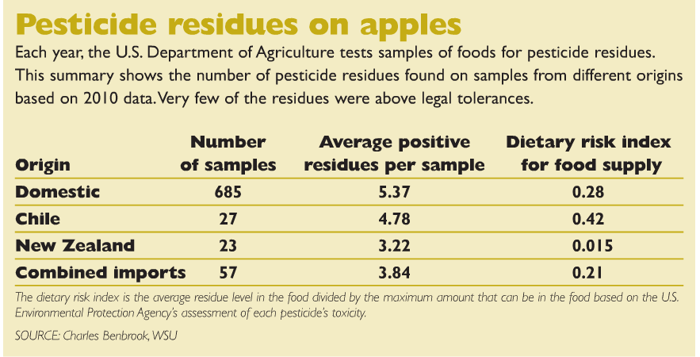
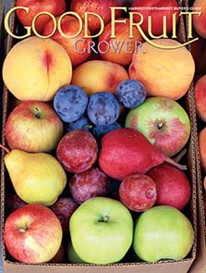

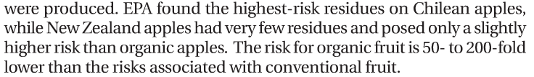
Apple Futures international recognition
New Zealand’s pesticide residue profile
✓
✓
Good Fruit Grower
August 2012
Turning a threat into a market opportunity
“
”

Slide 13
Success in the ‘IFP’ to ‘Apple Futures’ story
A market imperative & also an opportunity
Identifying the problem(s) and solution(s)
Getting grower on-board: rewards/incentives
Setting achievable goals & timelines
Challenge
Responsiveness to customers
IFP’s philosophical appeal
‘Safer’ orchard environment
Maximised use of biocontrol
Future-proofing of sector
Embraced change – can do it!
Vision
Leadership
Confidence in leadership
“to keep everything on track”
Getting off to a ‘good start’
Managing all expectations
Charting & reporting successes
Acknowledging your mistakes
IFP &
Apple Futures
Success
A science/sector led innovation
Created a sense of excitement
New concepts & technology
Sector-wide & multiple agency
Govt. + industry funding
Multiple & ongoing innovations
Innovation
Trust
Integrity, trust & respect
“without trust you have nothing”
Trusted access to sensitive data
Sensitive to grower concerns
Sensible management of risk
Fixed resistance & export fails
‘Crisis’ turned into ‘opportunity’
Building on IFP successes
‘IFP’ catalysed ‘Apple Futures’
Grower pride in achievements
Grower ownership of IFP
Solutions
Participation
Discussion groups were popular
Social support, while learning
‘Learning by doing’
Pilot ’test’ programmes (de-risk)
Acknowledge & manage risks
Management of uncertainty
Support
Expert advice, responsive Q&A systems
Direct science/facilitator/grower interactions
Managing crop risks & grower expectations

Slide 14
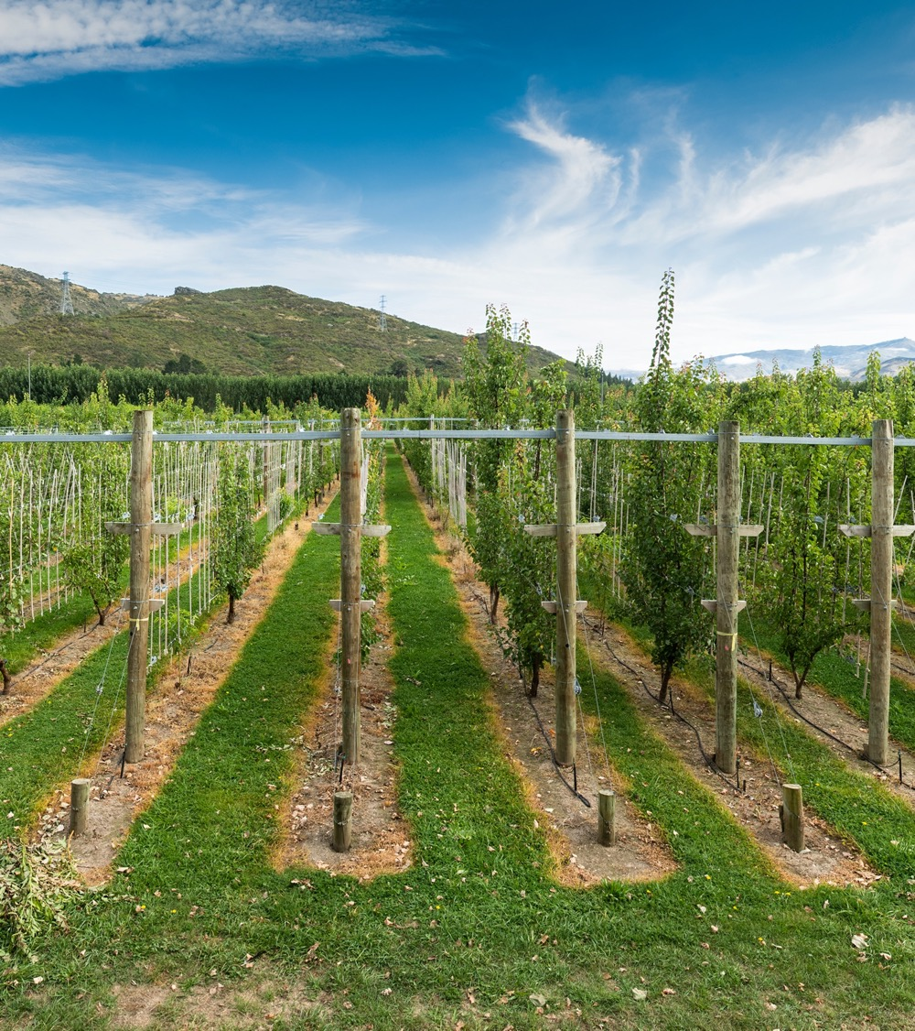
jim.walker@plantandfood.co.nz

